Slide 1

CSC 205 – C LOOPS
Week 6
Practice

Slide 2
C Loops
In programming, a loop is used to repeat a block of code until the specified condition is met.
C programming has three types of loops:
For loop
While loop
Do…while loop

Slide 3
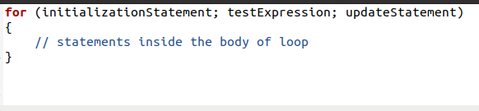
for loop statement
for loop
The syntax of the for loop is:

Slide 4

for loop statement
How it works
The initialization statement is executed only once.
Then, the test expression is evaluated. If the test expression is evaluated to false, the for loop is terminated.
However, if the test expression is evaluated to true, statements inside the body of the for loop are executed, and the update expression is updated.
Again the test expression is evaluated.

Slide 5
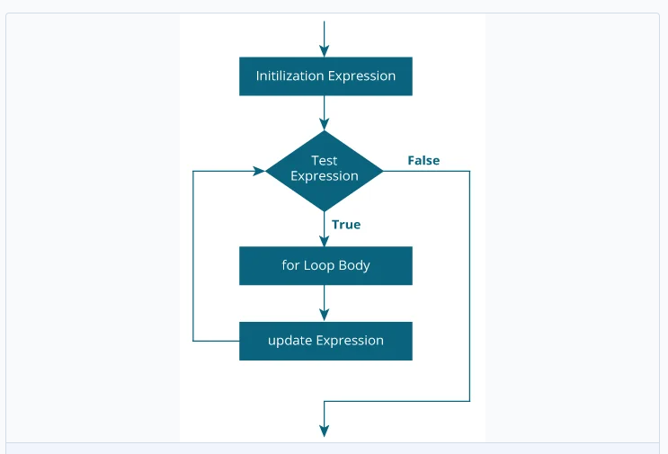
for loop statement
for loop flowchart

Slide 6
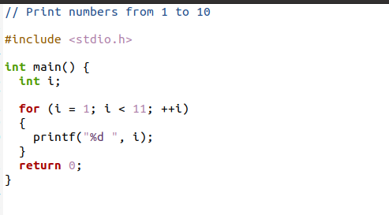
for loop statement
Exercise 1: Print numbers from 1 to 10

Slide 7
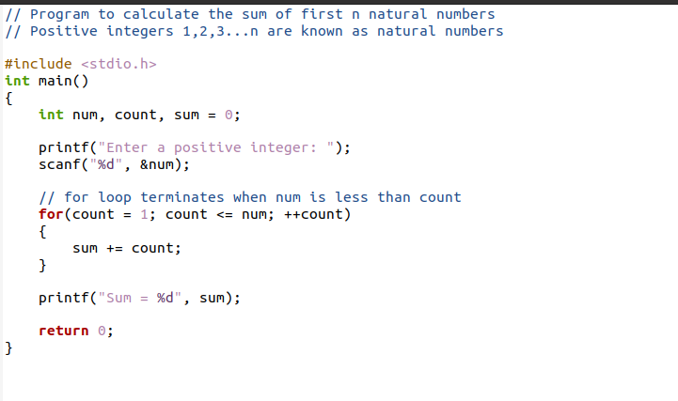
for loop statement
Exercise 2: Program to calculate the sum of first n natural numbers

Slide 8
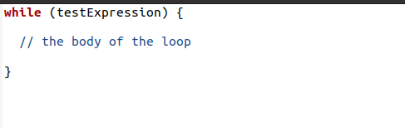
while loop statement
while loop
The syntax of the while loop is:

Slide 9
while loop statement
How it works
The while loop evaluates the testExpression inside the parentheses ().
If testExpression is true, statements inside the body of while loop are executed. Then, testExpression is evaluated again.
The process goes on until testExpression is evaluated to false.
If testExpression is false, the loop terminates (ends)..

Slide 10
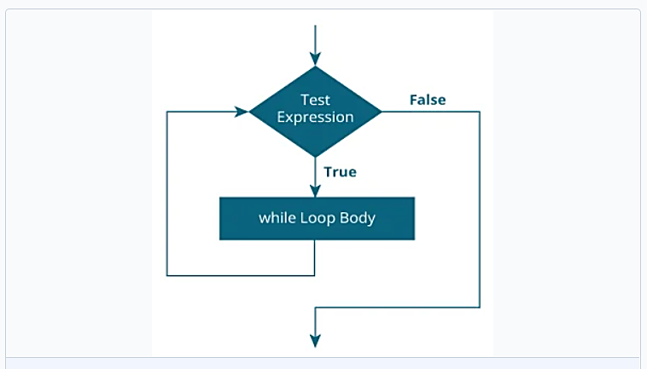
while loop statement
while loop flowchart

Slide 11
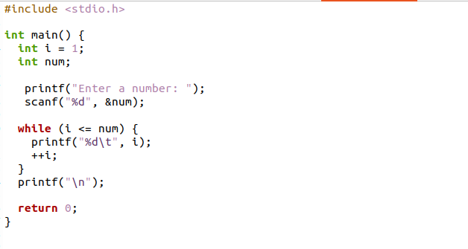
while loop statement
Exercise 3: Program to print numbers from 1 to n numbers

Slide 12
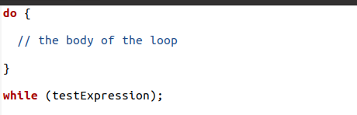
do…while loop statement
do…while loop
The do..while loop is similar to the while loop with one important difference. The body of do...while loop is executed at least once. Only then, the test expression is evaluated.
The syntax of the do...while loop is:

Slide 13
do…while loop statement
How it works
The body of do...while loop is executed once. Only then, the testExpression is evaluated.
If testExpression is true, the body of the loop is executed again and testExpression is evaluated once more.
This process goes on until testExpression becomes false.
If testExpression is false, the loop ends.

Slide 14
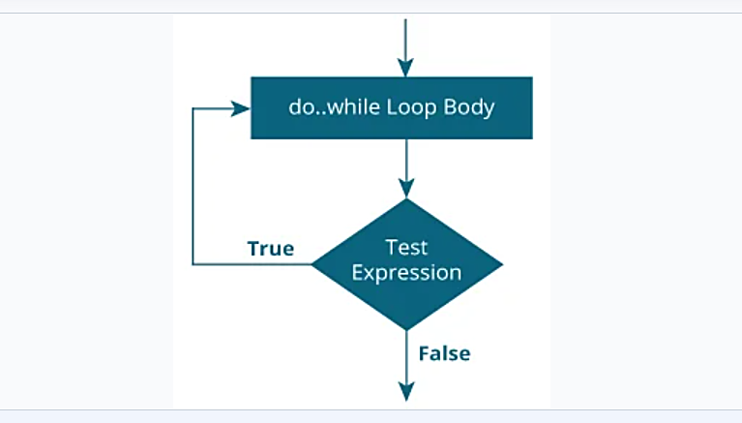
while loop statement
Flowchart of do…while Loop

Slide 15
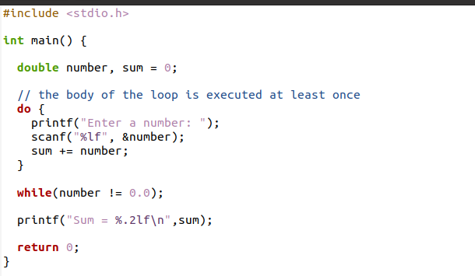
while loop statement
Exercise 4: Program to add numbers until the user enters zero

Slide 16
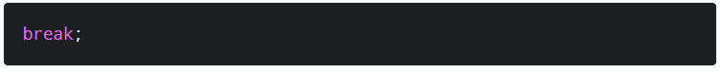
C break and continue
C break
The break statement ends the loop immediately when it is encountered.
The break statement is almost always used with if…else statement inside the loop.
Its syntax is:

Slide 17
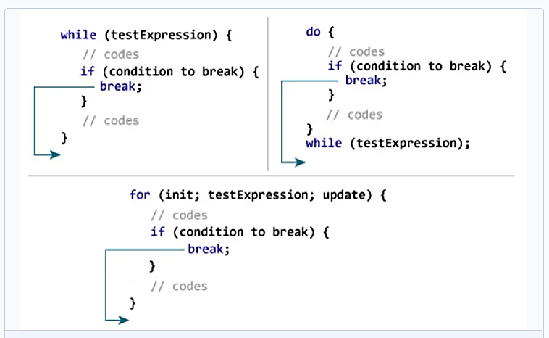
C break Statement
How it works

Slide 18
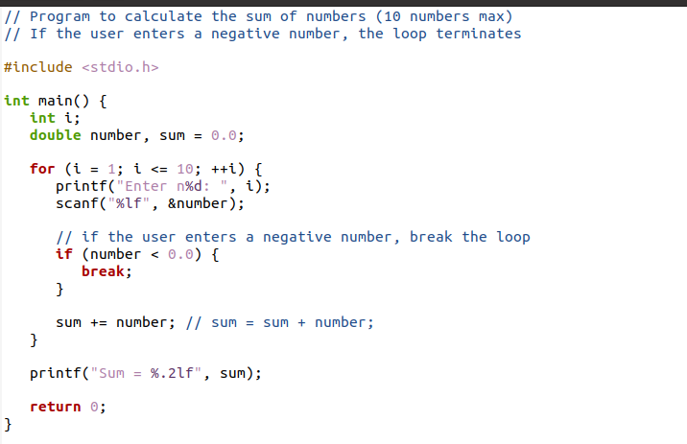
C break Statement
Exercise 5:

Slide 19
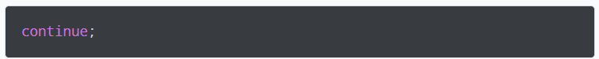
C break and continue
C continue
The continue statement skips the current iteration of the loop and continues with the next iteration.
The continue statement is almost always used with the if…else statement.
Its syntax is:

Slide 20
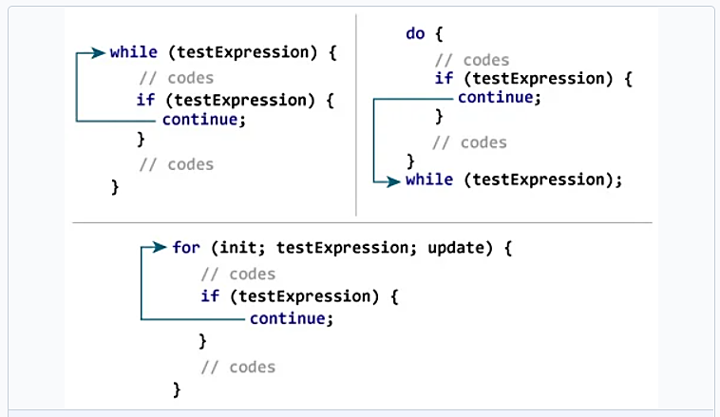
C continue Statement
How it works

Slide 21
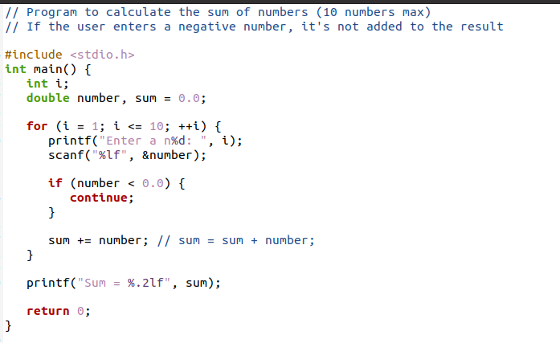
C continue Statement
Exercise 6:

Slide 22
C switch Statement
C switch…case
The switch statement allows us to execute one code block among many alternatives.
You can do the same thing with the if…else…if ladder.
However, the syntax of the switch statement is much easier to read and write.

Slide 23
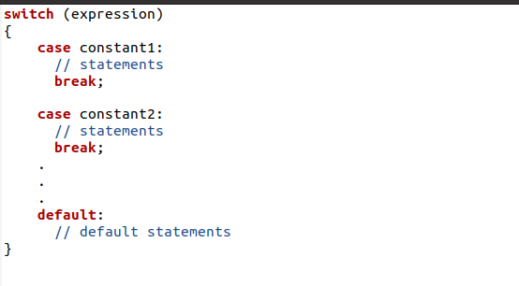
C switch Statement
Syntax of switch … case

Slide 24
C switch Statement
How does switch statement work?
The expression is evaluated once and compared with the values of each case label.
If there is a match, the corresponding statements after the matching label are executed. For example, if the value of the expression is equal to val2, statements after case val2: are executed until break is encountered.
If there is no match, the default statements are executed.
If the break is not use, all statements after the matching label are executed.

Slide 25
Switch Statements
Example:
Assume that we are going to program a simple calculator where user can select the operation by giving the choice. Say,
If they press 1, we should show the sum.
If they press 2, we should show the subtraction.
And so on.
In this kind of situation, we should go for switch statement.

Slide 26
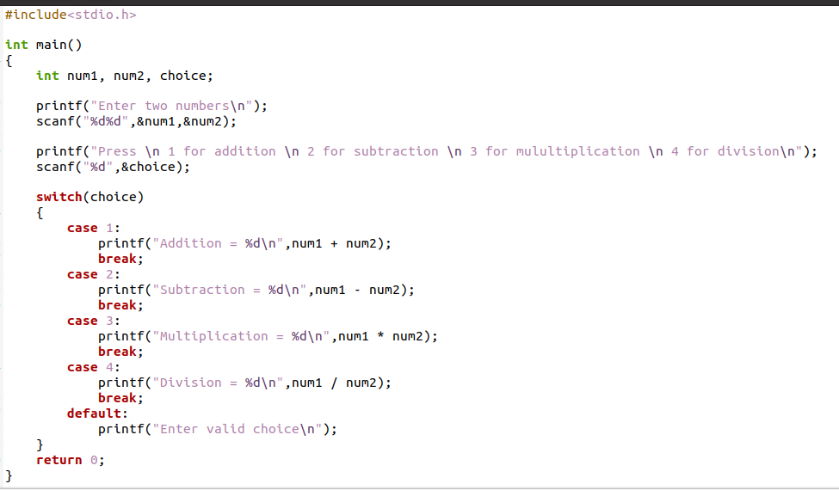
Switch Statements
Exercise 7: A simple calculator

Slide 27
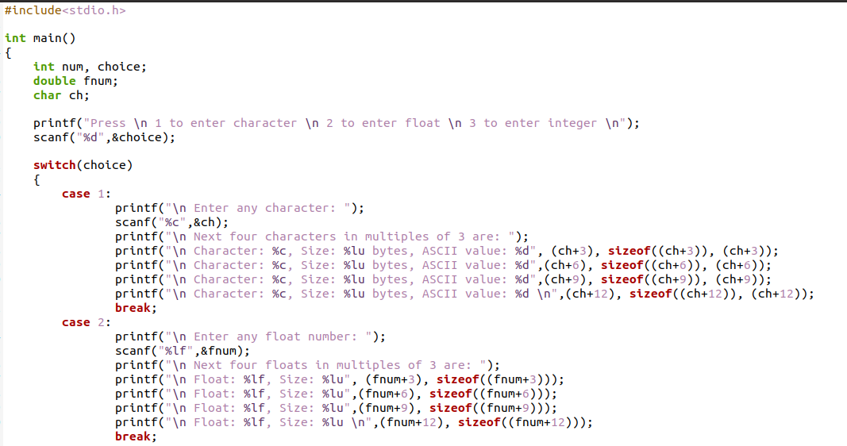
Switch Statements
Exercise 8: A program that accepts any character, float or integer, and prints the next four characters, floats or integers in multiples of 3

Slide 28
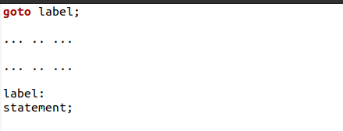
goto Statement
goto statement
The goto statement allows us to transfer control of the program to the specified label.
Syntax of goto statement
The label is an identifier. When the goto statement is encountered, the control of the program jumps to label: and starts executing the code.

Slide 29
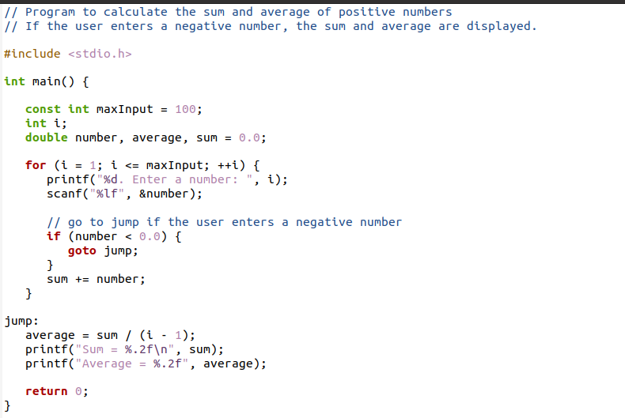
goto Statement
Exercise 9:

Slide 30

Class Project I
Welcome to Mama Cas Restaurant
Menu Price
P = Poundo Yam/Edinkaiko Soup - N3,200
F = Fried Rice & Chicken - N3,000
A = Amala & Ewedu Soup - N2,500
E = Eba & Egusi Soup - N2,000
W = White Rice & Stew - N2,500
Using Switch statement, write a program that displays the following menu for the food items available to take order from the customer.
The program inputs the type of food and quantity. It finally displays the total charges for the order according to price criteria.

Slide 31
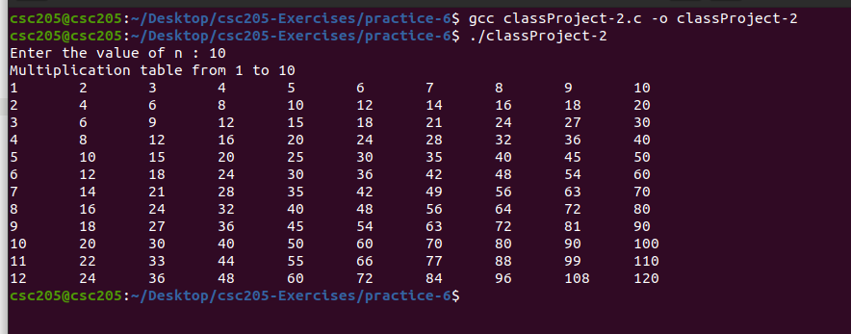
Class Project II
Using a nested for loop write a program in C to display the multiplication table vertically from 1 to n, such that the output will be:

